Slide 1
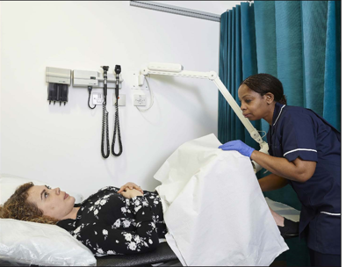
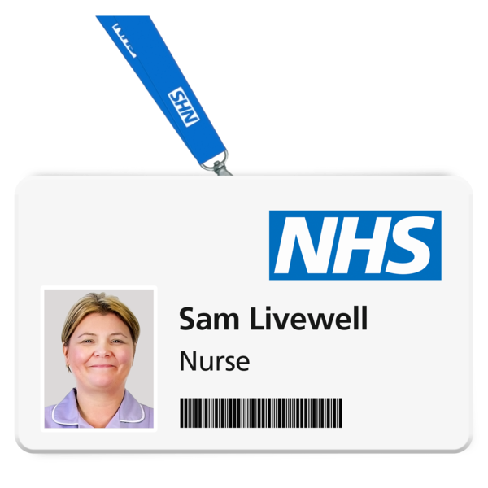
You are invited to your Cervical Screening
Write some short information and a picture about your meeting or event in this space. This template makes 2 A5 invitations.
When: Someday 28 Month
Time: 10am to 3.30pm
Where: The Old Surgery,
24 Old Street, Old Town OJ228 7PS
For more info:
0117 959 4424
Month
28
Email
yourname@youremail.com
10.00 am
3.30 pm
Your Cervical screening will be done by your practice Nurse e.g., Sam Livewell (please insert Nurses picture)
Please let your nurse know if you need any help attending your appointment.
Phone the number above if you are unable to attend the appointment.

