Slide 1

Education Specific
Hertfordshire
Prepared for SEND Inspection
Information Session
January 2023

Slide 2
Aim of this session
To present information regarding SEND inspection to early years settings, schools and colleges who are part of Hertfordshire’s Area SEND Partnership
To help you prepare for a SEND inspection, ensuring you are aware of the format and scope of an inspection and know what to do if you are visited
To reflect on key messages and practice

Slide 3

SEND Is Everybody’s Business

Slide 4


What is a SEND Area Inspection?
Ofsted and CQC inspect area arrangements for children and young people (CYP) with special educational needs and/or disabilities (SEND) in England
A new inspection framework was published in November 2022. You can access the framework through this link
Once inspections start, Hertfordshire is expected to be one of the first areas to be visited under this new framework
Inspectors assess the extent to which area partners are complying with relevant legal duties relating to arrangements for CYP with SEND
Includes all CYP with SEND aged 0 to 25 covered by the SEND code of practice, including those who have an EHCP and those who receive (SEN) support.
Includes CYP who live in the local authority area but attend education settings or receive services outside of the local authority’s geographical boundaries.
Does not include CYP who live in other local authority areas but attend education settings in Hertfordshire.

Slide 5
This is an inspection of the Hertfordshire SEND Area Partnership and it’s impact on children and families.
Area Partnership refers to those in education, health and care who are responsible for the strategic planning, commissioning, management, delivery and evaluation of arrangements for children and young people with SEND who live in Hertfordshire.

Slide 6
Inspectors evaluate partnership working
Focus across all services – Education, Health and Care
Looking at how partners works together
Are ambitious for children and young people with SEND
Actively engage and work with CYP and families
Have an accurate and shared understanding of CYP needs
Commission services and provision to meet needs and aspirations, including alternative provision
Evaluate services and make improvements
Create an environment for effective practice and multi-agency working to flourish

Slide 7
Inspectors evaluate whether children and young people…
Have their needs identified accurately and assessed
in a timely and effective way
Participate in decision-making
Receive the right support at the right time
Are well prepared for their next steps and achieve strong outcomes
Are valued, visible and included in their communities

Slide 8
Possible outcomes of inspection
Inspectors will make an overall summary judgement about the Hertfordshire SEND partnership.
The area partnership’s arrangements typically lead to positive experiences and outcomes for children and young people with SEND
Next inspection within 5 years
Publish strategic plan
The area partnership’s arrangements lead to inconsistent experiences and outcomes for children and young people with SEND. The local area partnership must work jointly to make improvements.
Next inspection within 3 years.
Publish strategic plan
There are widespread and/or systemic failings leading to significant concerns about the experiences and outcomes of children and young people with SEND, which the local area partnership must address urgently.
Monitoring inspection within 18 months, full inspection in 3 years
Prepare and submit a priority action plan

Slide 9
Format of inspection
Inspection lasts 3 weeks from point of notification
Inspection team led by Her Majesty’s Inspector (HMI) from Ofsted
Team will also include Children’s Services Inspectors from the CQC, and education and social care inspectors from Ofsted.
Week 1
submit evidence and data to the inspectors.
identify at least 6 children to track during the inspection
coordinate sending out online surveys to children, parents and practitioners.
Week 2
inspectors will meet with groups of CYP and parents.
tracking meetings for the 6 CYP identified in week 1, reviewing their experiences and journeys through the SEND system.
this will include meetings with the CYP and their families, as well as multi-agency meetings with the practitioners who have worked with them.
Week 3
Inspectors visit Hertfordshire
Visit providers and education, health and care services
Review records on case management systems
Meet with senior leaders
Meeting with practitioners to discuss specific lines of enquiry
Hold feedback meeting with local area senior leaders

Slide 10
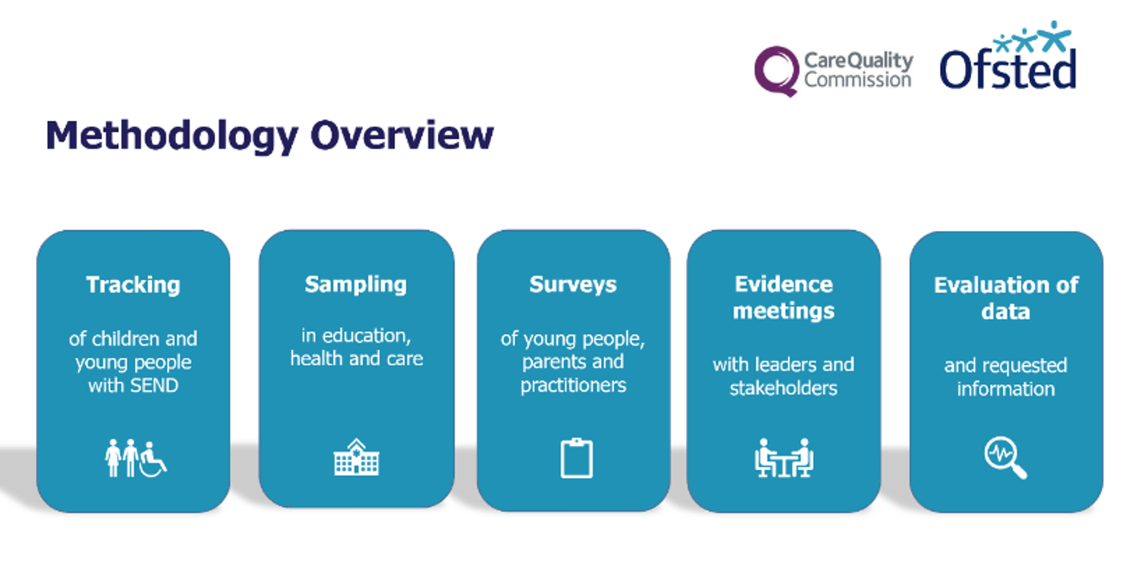
Methodology Overview

Slide 11
How the inspection might affect you
You may support a CYP and their case is reviewed by inspectors as part of the tracking exercise
During the inspection, inspectors will visit providers such as early years settings, schools, alternative provision, colleges and specialist services to gather evidence as part of sampling visits.
Staff in your setting may be asked to meet with an inspector(s) to discuss a particular CYP or family either 1-1 or in a multi-agency tracking meeting
You may be asked to support with provision of evidence requested by an inspector

Slide 12
Tracking exercise
During week 1, inspectors will select approximately 6 children and young people to be involved in tracking meetings.
Tracking meetings enable inspectors to understand specific children and young people’s experiences and journeys through the SEND system.
These are meetings with children and young people, their parents or carers (if appropriate) and the practitioners who are directly involved with them.
Inspectors will usually include at least one child or young person who is studying in alternative provision, and at least 2 children who are receiving SEN support.
If someone from your setting is required to attend a multi-agency tracking meeting, you will be contacted during the inspection to provide you with more information and to nominate a suitable practitioner who knows the child/family well

Slide 13
Sampling visits
Ofsted and CQC will select providers and services to visit
These visits may include settings such as nurseries, schools, colleges, alternative provision and specialist services.
These visits are to review the experiences of a wider group of children and young people
The lead HMI will provide the LA with notification letters to send to the chosen education, health and care providers. The LA will contact you if your setting is selected for a visit.
During sampling visits, inspectors will ask for information about individual children and young people’s experiences. These may include children and young people who have a specific need, who are receiving a specific service and/or who are at a particular point in their care or education.
  Examples include those CYP who have high rates of absence, are on part-time timetables, are known to youth justice
Inspectors will look at any documents relating to the children and young people
They may meet children and young people during their visit
They will speak to practitioners who know the children and young people

Slide 14
Case Study: Kent SEND re-visit (2022)
“Many schools welcome children with SEND and ensure that they receive a high quality of education and care. These schools typically engage well with the local authority and attend training and update events relating to SEND. Some schools offer a warm welcome to children with SEND and their families, but participate less in locally offered training or networking events. Other schools neither participate in opportunities to share and learn from good practice nor overtly welcome children with SEND.”
“The inclusive quality of provision in Kent’s schools remains hugely variable. Some school leaders, heavily involved and engaged in trying to shift the culture of inclusion, state that it has regressed since the previous inspection. Young people with SEND spoke articulately to inspectors about a lack of understanding of their needs from staff at schools or colleges they have attended. “
“Parents do praise the hard work and support of many individual schools, medical and local area staff and organisations. However, parents feel that they are ‘lucky’ if they find someone who listens to, and acts on, their concerns.”

Slide 15
Case Studies: Hertfordshire School Inspections (2020 - 2022)
Areas of strength
“Leaders are ambitious for all pupils, including pupils with special educational needs and/or disabilities (SEND). Leaders ensure that pupils with SEND get the help that they need. There are clear systems in place to help early identification and leaders make good use of specialist services. Teachers adapt their plans so that pupils with SEND can access the same curriculum as their peers.”
"This is an inclusive school where everybody is valued. Pupils with a range of special educational needs and/or disabilities (SEND) have their needs met well.
Leaders identify the needs of pupils with SEND accurately. Staff are well supported to plan and deliver learning that ensures pupils with SEND access the same ambitious curriculum as their peers. Where adaptations are required, for example personalised timetables, leaders work with external agencies effectively and appropriate specialist help is used to support pupils well. "
“The curriculum meets the needs of pupils with special educational needs and/or disabilities (SEND). Pupils with SEND are well supported so that they are fully involved in school life. Staff make expert use of information in pupils’ education, health and care plans to decide the best way for each pupil to learn. Pupils with SEND, and disadvantaged pupils, progress exceptionally well in the curriculum.”

Slide 16
How your setting can prepare
Ensure your website is up-to-date and includes your SEN Information report, link to Local Offer and clear information for parents
Be aware of % CYP being identified as having a SEND in your setting
Ensure that someone is available during visits who can access all case files and documents
Ensure that staff who meet with inspectors know the CYP and their families well
Have data available on outcomes for children with SEND, including exclusions and attendance
Ensure you have robust processes for assess, plan, do, review

Slide 17
How you can prepare
Have in your mind work you are proud of because of the difference it has made to CYP & families
Ensure your records are updated and always reflect the voice of the child, young person and family
Familiarise yourself with the CYP you support and their EHCP - the outcomes in their EHCP should align with your work
Visit Hertfordshire SEND Inspection One-stop Shop and familiarise yourself with the new framework
Read the SEND Strategy 2022 - 2025 and think about how your work contributes to our ambitions
Ensure that you have a regular item on the agenda at team meetings to discuss how you are preparing

Slide 18
When meeting inspectors
Be relaxed and confident about the good work you have done
Have at least two good examples of CYP and families that you support ready to talk about if you are asked, as well as some that are going less well – think about how you would talk about these
Know the key messages you need to get across, know your CYP and families, know where the documents within your case files are, and be able to talk about the good outcomes you have achieved to improve the lived experience for the child/children
Talk about the good work you have done with multi-agency partners i.e. social care, health, education, young people services, police which have resulted in improved outcomes for the child
Make sure you are in control of what you show the inspectors. If it is a face to face visit, ask to use your own laptop/desktop and hold on to your keyboard and mouse
Ensure you feedback to your manager straight after the inspector has gone

Slide 19
When meeting inspectors (2)
Try not to worry – you have good work to be proud of
Don’t get rattled if you don’t know the answer to a question, just say you will find out and get back to them
Don’t get into conversations about areas you are not sure about, steer the conversation away and back to what you know
Don’t complain about or bad mouth other teams or other agencies – we are all in this together
If you are asked to select CYP and families that you support, don’t select any that you are not 100% confident about
Whilst you can show inspectors records on your screen, don’t share or send any evidence, data or audits to them, as this must be sent via a central point. Contact SENDInspection.Comms@hertfordshire.gov.uk if you have been asked to share additional information with inspectors

Slide 20

Remember that the Hertfordshire Local Offer is a great source of information for you, CYP and parents, continue to promote it in your communications

Slide 21

SEND Ambitions 2022-2025

Slide 22
Thank you for listening
Slides will be available on Hertfordshire SEND Inspection One-stop Shop
If you have any questions please speak to your line manager or you can email SENDInspection.Comms@hertfordshire.gov.uk

